Slide 1
30 Days Python Class
Basic Introduction

Slide 2
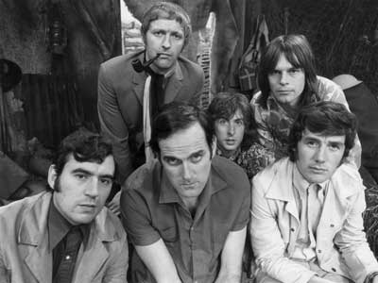
Python!
Created in 1991 by Guido van Rossum (now at Google)
  Named for Monty Python
Useful as a scripting language
  script: A small program meant for one-time use
  Targeted towards small to medium sized projects
Used by:
  Google, Yahoo!, Youtube
  Many Linux distributions
  Games and apps (e.g. Eve Online)

Slide 3
Interpreted Languages
interpreted
  Not compiled like Java
  Code is written and then directly executed by an interpreter
  Type commands into interpreter and see immediate results
Java:
Code
Compiler
Runtime
Environment
Computer
Python:
Code
Interpreter
Computer

Slide 4
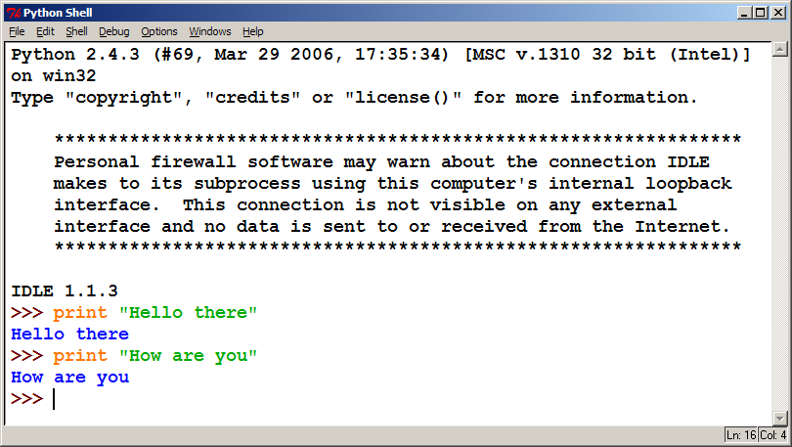
The Python Interpreter
Allows you to type commands one-at-a-time and see results
A great way to explore Python's syntax
  Repeat previous command: Alt+P

